Slide 1
Coral Reefs
Species Richness variation with Differentiating Latitudes
By Cesar Lopez

Slide 2
Introduction/Background TO Research
Benthic surveys were conducted for different species
This also included corals and other organisms
National Coral Reef Monitoring Program (NCRMP)

Slide 3
Question Asked & Why It’s Important
Does species variation differ with changing latitudes
Important to know because:
-It can help us better understand richness -It can relate species richness to latitudes

Slide 4
Methods
Data was found and imported to R
Data was fitted to Generalized Linear Models (GLMs)
Model used was determined through AIC comparison
Plot was charted in R with ggplot2
Both GLM and no GLM used for plot

Slide 5
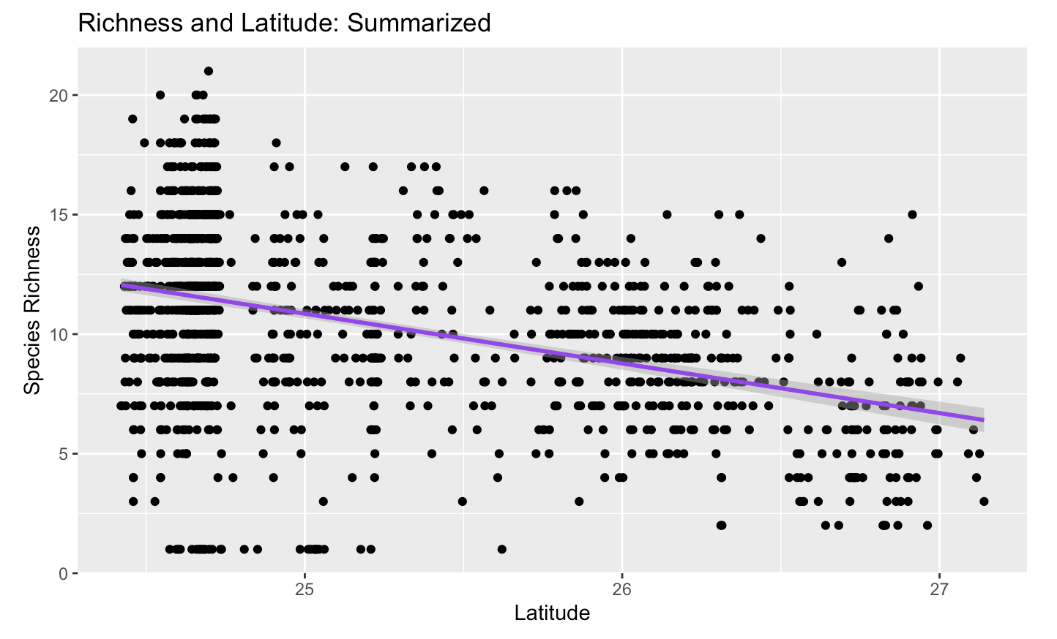
Results
Fig. 1. The following plot was fitted without using the GLM. Shows a downward trend for richness in correlation to diversity.

Slide 6
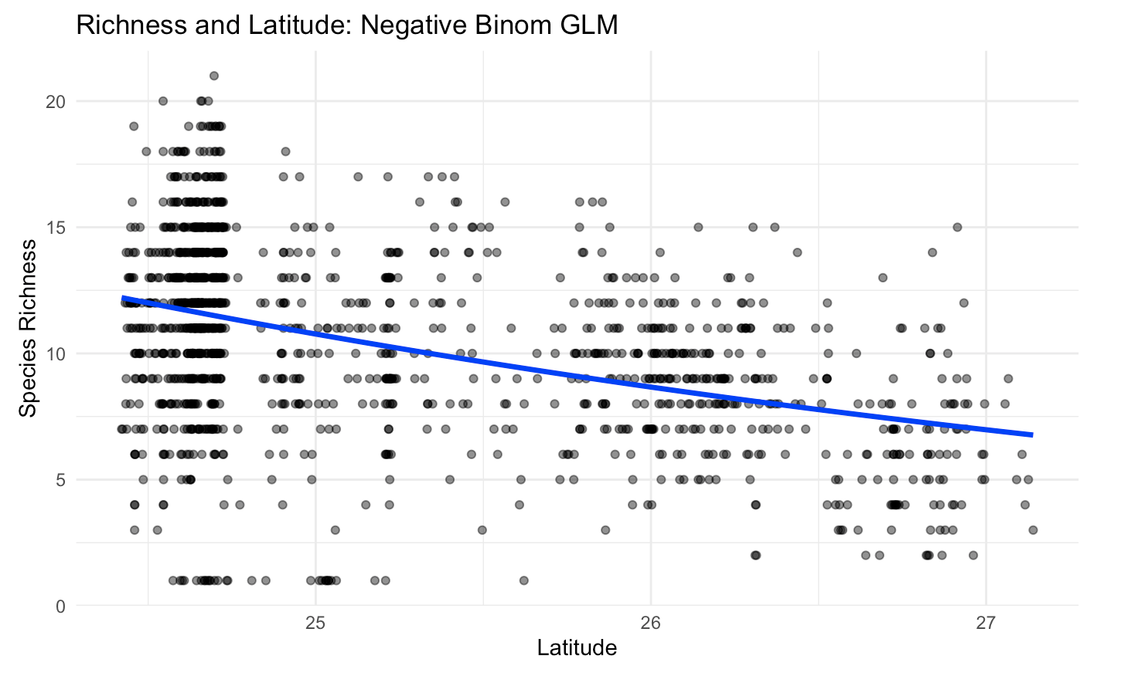
Results
Fig. 2. The following graph is one fitted using the Negative Binomial GLM. The result is the same as the one without the model being fitted.

Slide 7
Resources/References
NOAA National Centers for Coastal Ocean Science (NCCOS); Southeast Fisheries Science Center (SEFSC); University of Miami Rosenstiel School of Marine and Atmospheric Science (UM-RSMAS); Nova Southeastern University (NSU); Florida Fish and Wildlife Conservation Commission (FWC); Florida Department of Environmental Protection (FDEP); National Park Service (NPS); Florida Keys National Marine Sanctuary (FKNMS); Broward and Miami-Dade counties (2018). National Coral Reef Monitoring Program: Assessment of coral communities in the Florida Keys Reef Tract from 2016-05-01 to 2016-12-15 (NCEI Accession 0169401). https://www.ncei.noaa.gov/archive/accession/0169401. In NOAA Southeast Fisheries Science Center; NOAA National Centers for Coastal Ocean Science. National Coral Reef Monitoring Program: Assessment of coral reef benthic communities in the Florida Reef Tract. [indicate subset used]. NOAA National Centers for Environmental Information. Dataset. https://doi.org/10.7289/v5xw4h4z. Accessed December 9th, 2025.

